Slide 1
Exception Handling
Non Credited
Dr. Zahid Halim

Slide 2
Introduction
Exception handling
  Create application that can handle or resolve exception
    Enable clear, robust and more fault-tolerant programs

Slide 3
Exception Handling Overview
Keywords
  try
    Include codes in which exceptions might occur
  catch
    Represent types of exceptions the catch can handle
  __finally
    (Optional) code present here will always execute

Slide 4
Example: DivideByZeroException
Error catching
  Method Convert::ToInt32 will detect invalid representation of an integer
    Method generates a FormatException
  CLR automatic detection for division by zero
    Occurrence will cause a DivideByZeroException

Slide 5
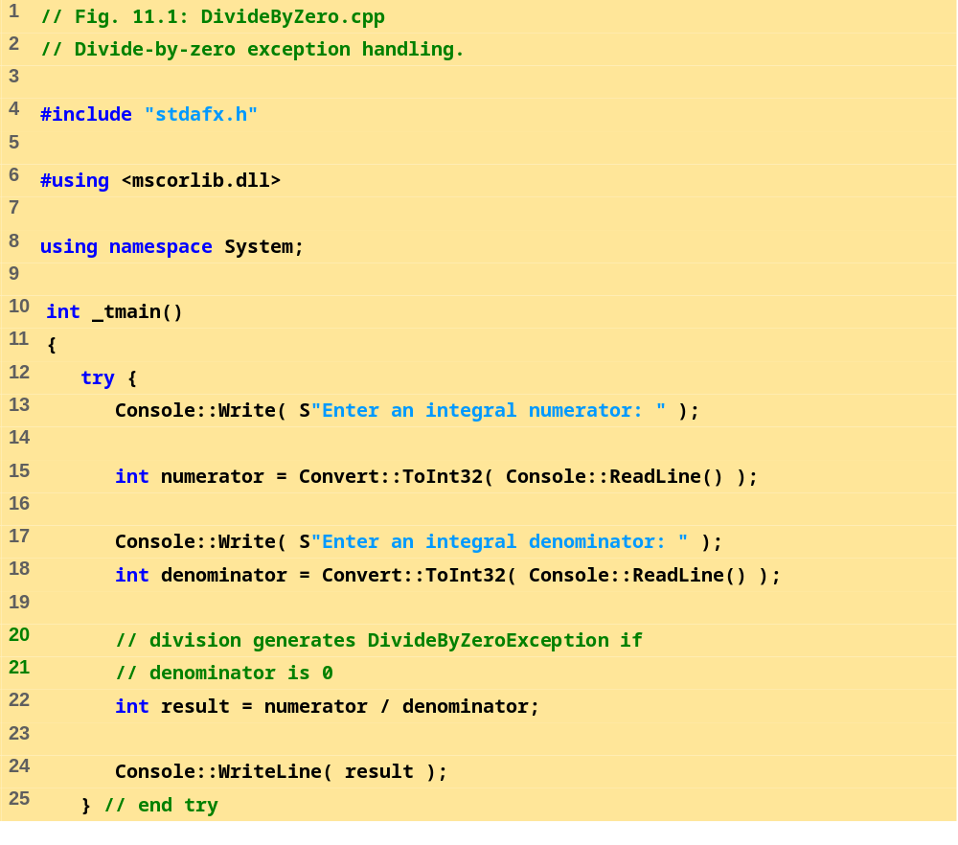

Slide 6
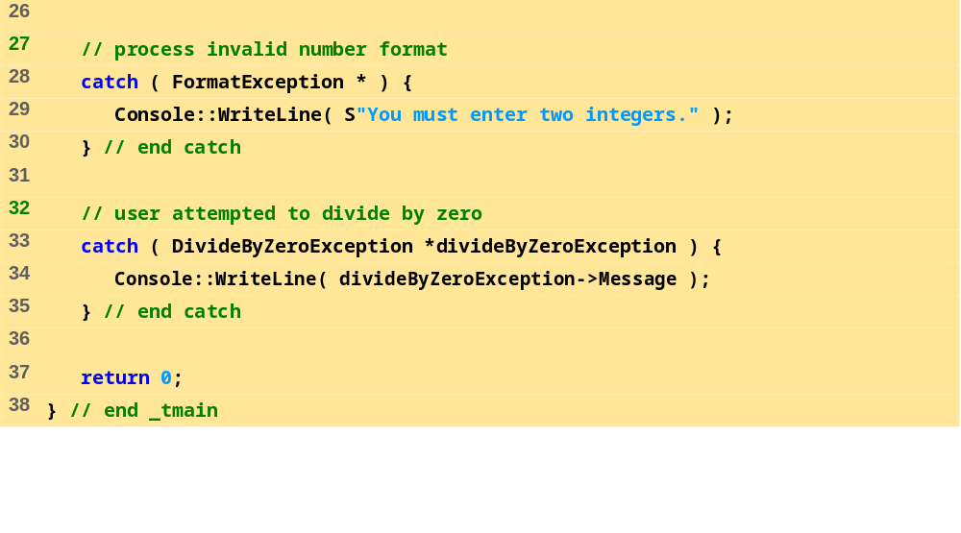
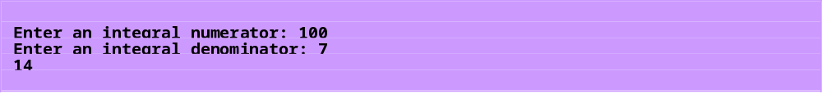
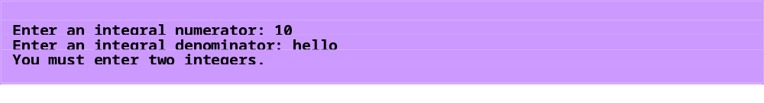
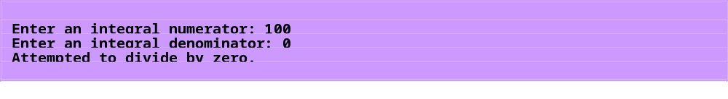

Slide 7
.NET Exception Hierarchy
.NET Framework
  Class Exception is base class
  Derived class:
    ApplicationException
      Programmer use to create data types specific to their application
      Low chance of program stopping execution
    SystemException
      CLR can generate at any point during execution
      Runtime exception
      Example: IndexOutOfRangeException

Slide 8
__finally Block
Resource leak
  Improper allocation of memory
__finally block
  Ideal for placing resource deallocation code
  Execute immediately after catch handler or try block
  Must be present if no catch block is present
  Is optional if one or more catch handlers exist

Slide 9
__finally Block
The throw expression
  An exception object
  Must be of either class Exception or one of its derived class
  Customize the exception type thrown from methods

Slide 10
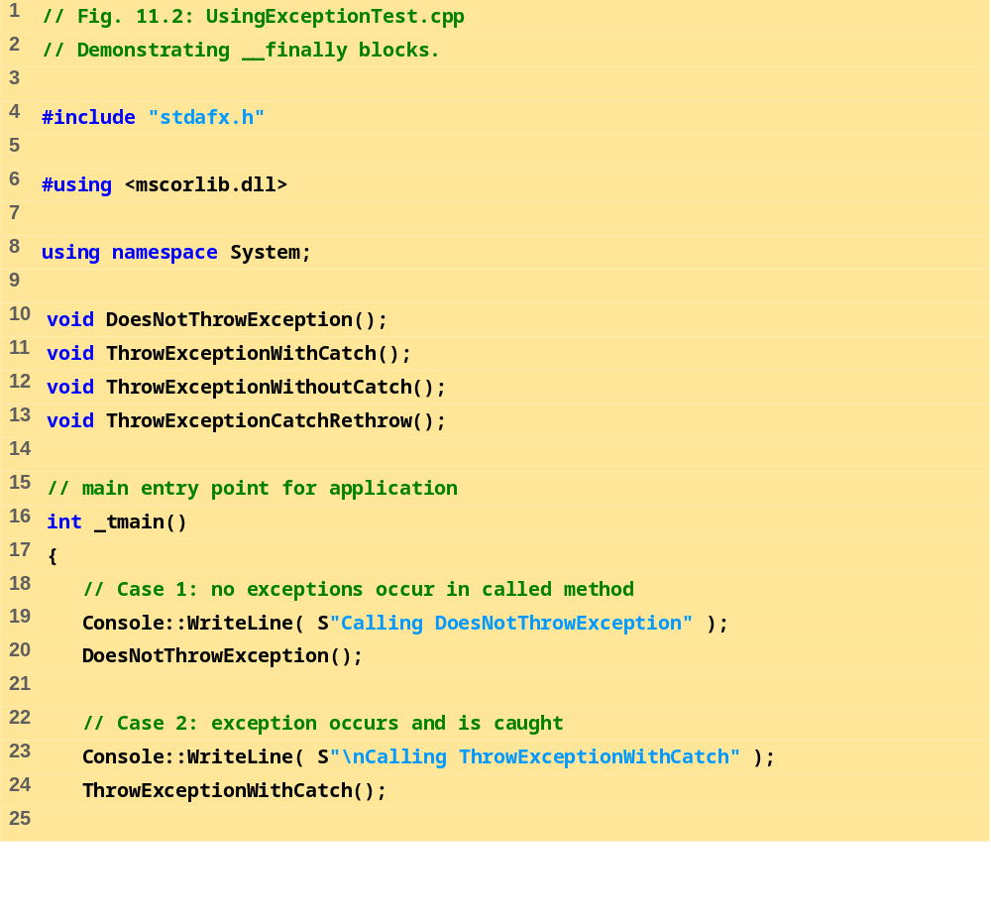

Slide 11
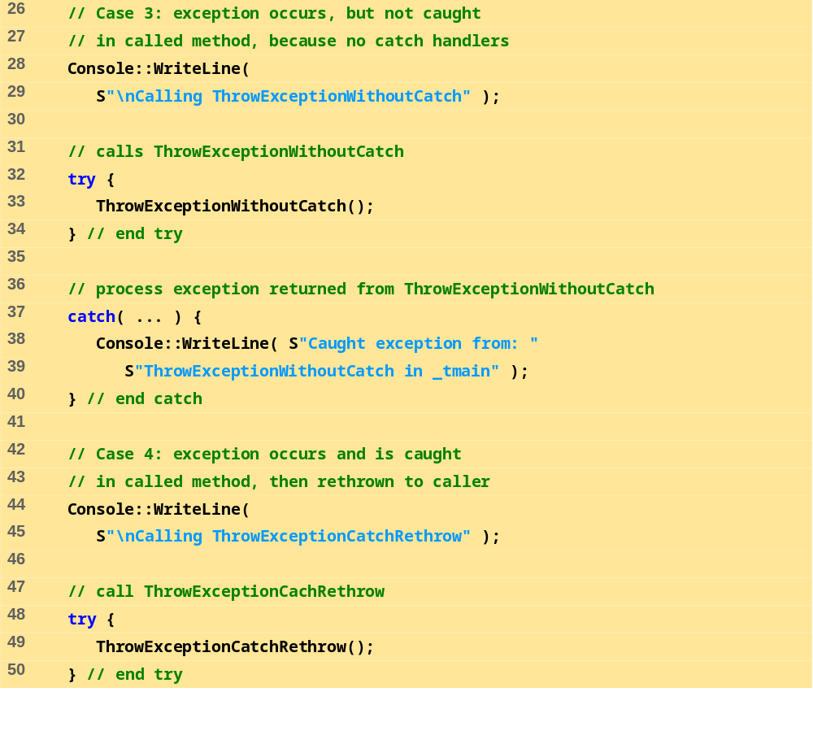

Slide 12
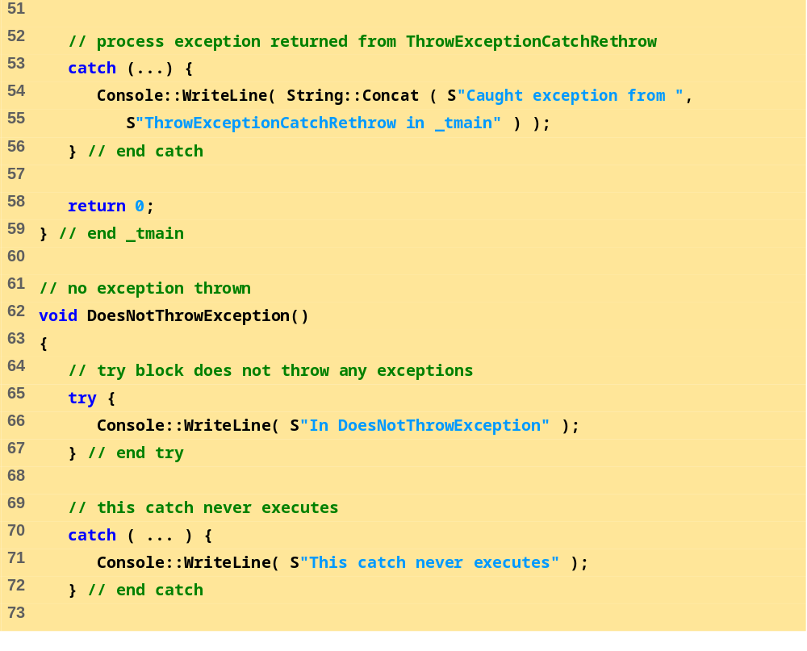

Slide 13
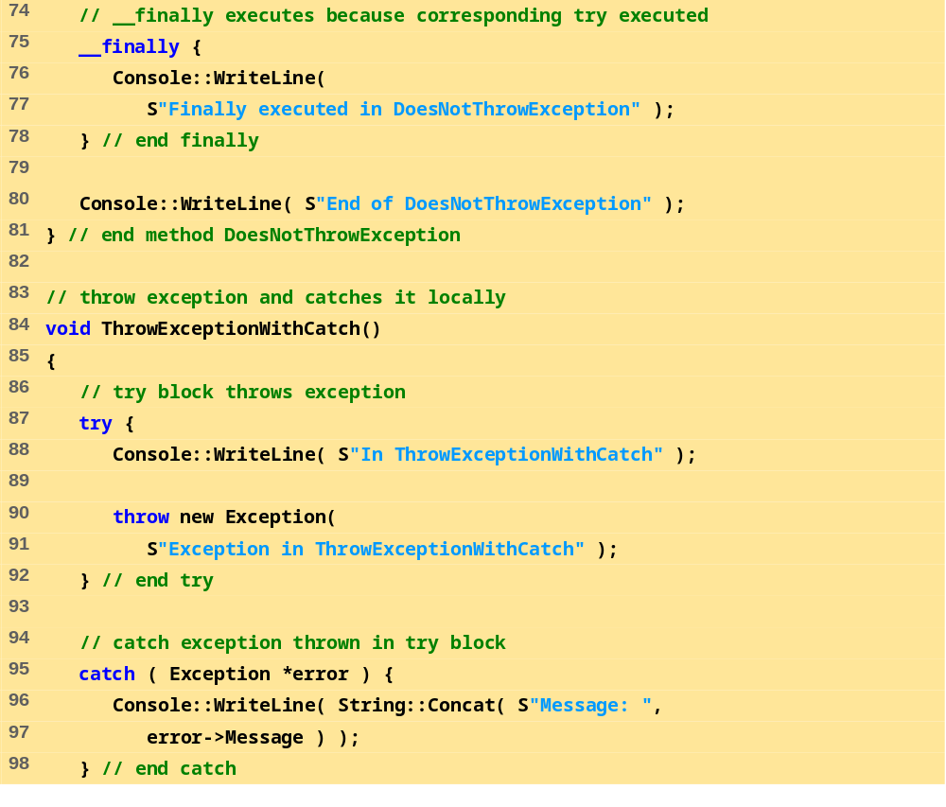

Slide 14
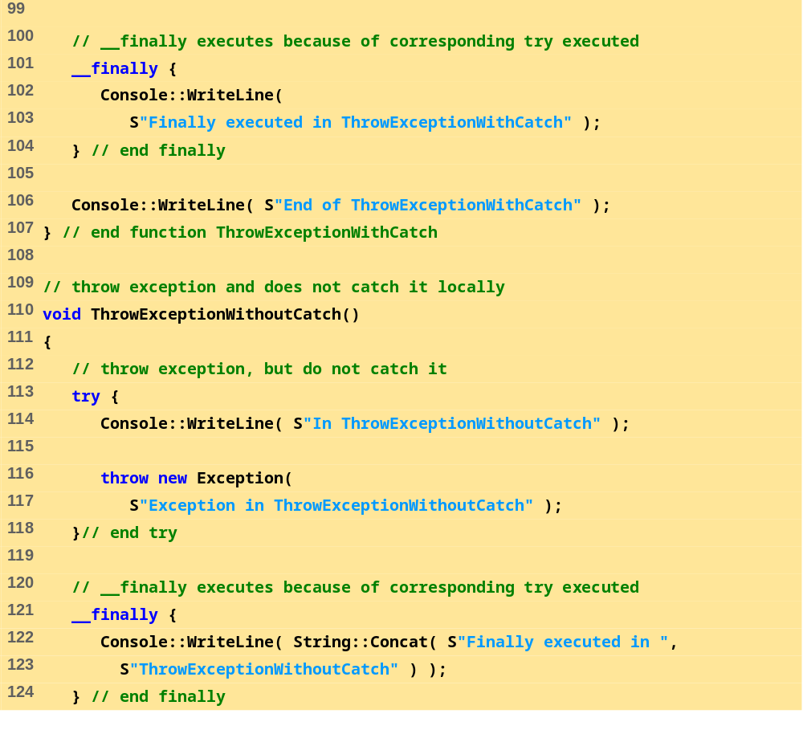

Slide 15
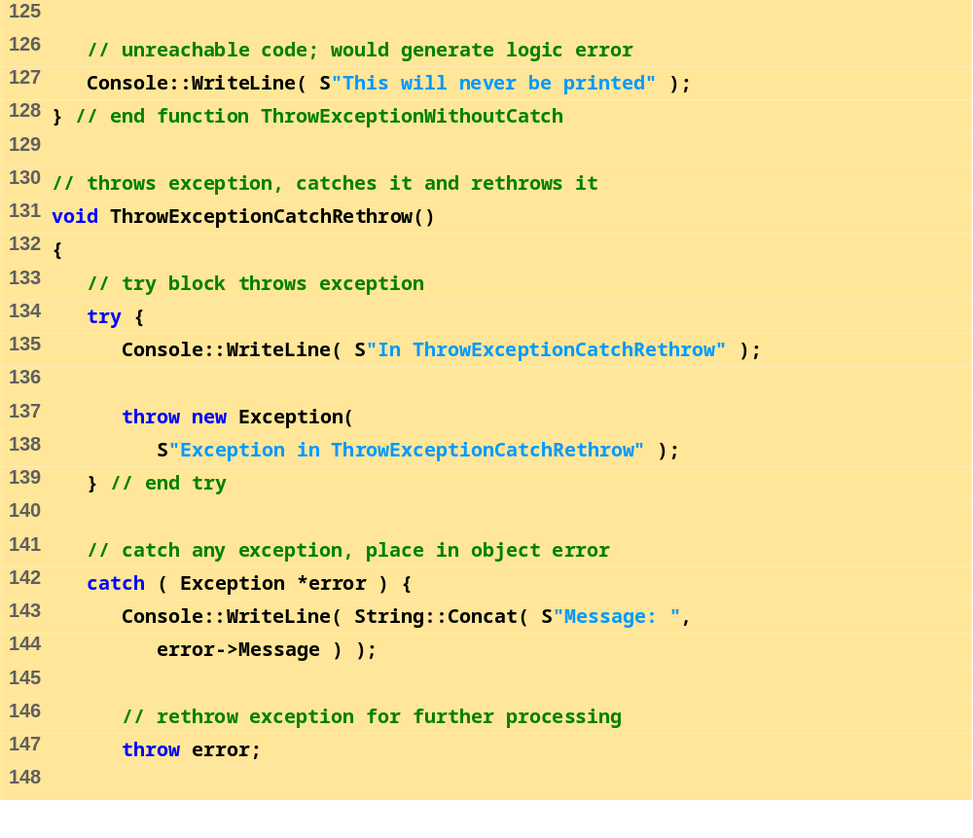

Slide 16
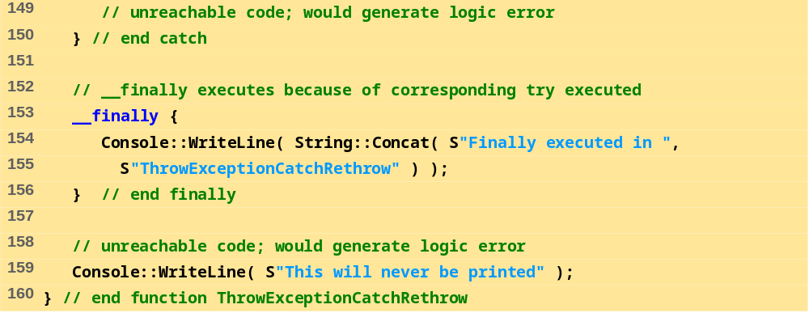
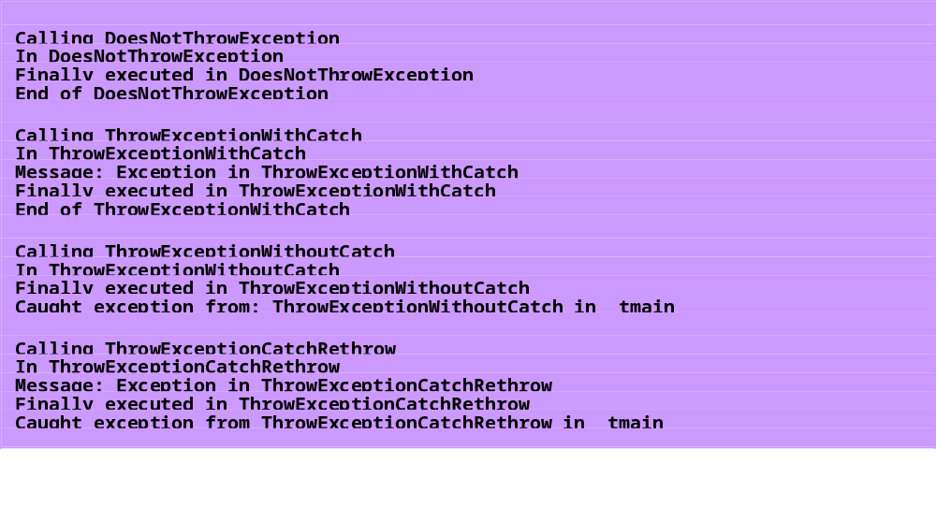

Slide 17
References
Book Code: A

